Slide 1

CENTENNIAL COLLEGE
Web Interface Design – 22F
STATIC-PORTFOLIO
WEBSITE
Presented by Mohammed Saad
301313784
Notes:
Imagine you are the owner of a small software development firm who wants to expand but is constrained by factors such as a small team size, unpredictability of demand, and limited resources - this is where cloud computing comes in. Hello, my name is Mohammed Saad, and I am a student in the AI and ML diploma program at CC. Today, I am going to discuss my experience implementing and investigating a cloud offering called Storage.

Slide 2

SUMMARY OF CONTENTS
About Me & Intro
Timeline
Project Overview
Hosting
Conclusions
Questions
BUILDING A STATIC PORTFOLIO WEBSITE
SAAD
Notes:
I have basically used storage service called buckets in AWS to host my static portfolio website which I am currently building for my Web Interface Design Course. A static website is one with stable content, where every user sees the exact same thing on each individual page. On the other hand, a dynamic website is one where content change with the user e.g.: Google.

Slide 3
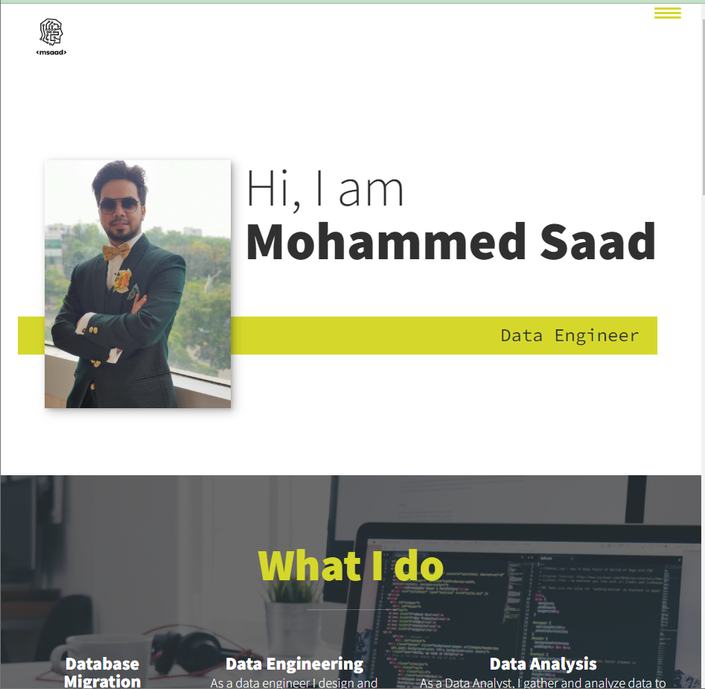
I am a Data Nerd | Blogger | Freelancer
Write about Cloud Computing
Share projects on GitHub & Medium
Help people in Career Change
SAAD
Notes:
Cloud computing is a basic concept in which we transfer computing capabilities that we previously consumed as products into on-demand services. There are five types of cloud services: IAAS, CAAS, PAAS, FAAS, and SAAS. In my implementation, I explored IAAS, which has raw storage, network, and computing capabilities.

Slide 4
INTRODUCTION
Why I need a Professional Website:
Hire Me – Portfolio and contact details
Learn more about me, projects etc.,
Blog – post new work and videos etc.,
Email signup, location and to contact me
https://www.gloomaps.com/plckHij4hG
SAAD
Notes:
Cloud computing is a basic concept in which we transfer computing capabilities that we previously consumed as products into on-demand services. There are five types of cloud services: IAAS, CAAS, PAAS, FAAS, and SAAS. In my implementation, I explored IAAS, which has raw storage, network, and computing capabilities.

Slide 5
BUILDING A PORTFOLIO WEBSITE
A BRIEF TIMELINE
WEEK 1
WEEK 2
WEEK 3
WEEK 4
WEEK 5
Index.html
Css/Jss
Adding Projects
Setting up AWS
PPT
SAAD
Notes:
More than 5 weeks ago, I had the option to choose a topic to investigate, and I also had to work on a project for my WID course - so I opted to combine both to dig deeper into cloud computing.

Slide 6



PROJECT OVERVIEW
BUILDING A PORTFOLIO WEBSITE
CREATE BUCKET AND ADD OBJECTS – HTML/CSS/JAVASCRIPT
UPDATE POLICIES
AVAILABLE TO THE WORLD
SAAD
Notes:
User Story :
As a Software Developer, I want to use AWS S3 to host my personal static portfolio website, so that I can share it to the world.

Slide 7
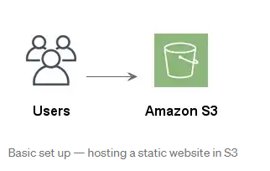
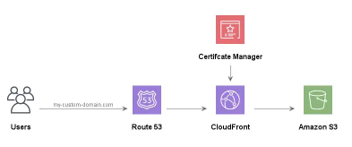
Basic Setup
Adding Existing Domain-Name
SAAD
Notes:
To configure a secure custom domain in CloudFront:
CloudFront is a global Content Delivery Network (CDN), which will host your website on a global network of edge servers, helping users load your website more quickly.
To use a custom domain requires a combination of Route 53 — Amazon’s highly available and scalable cloud DNS web service —it translates the domain name into numeric IP address. When someone visits your website, Amazon Route 53 will manage this domain name to IP address relationship this in a Hosted Zone.
Certificate Manager generates the SSL certificates.

Slide 8
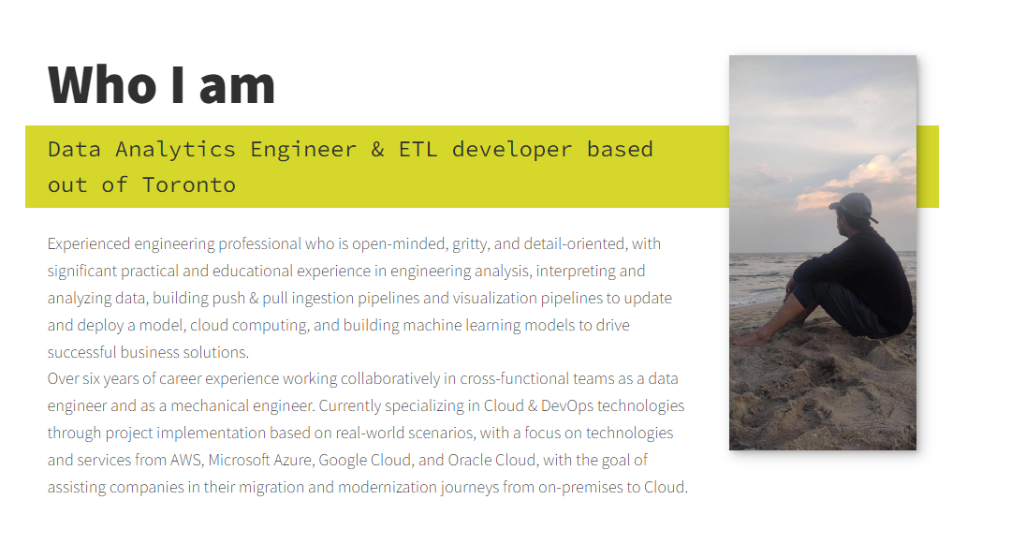
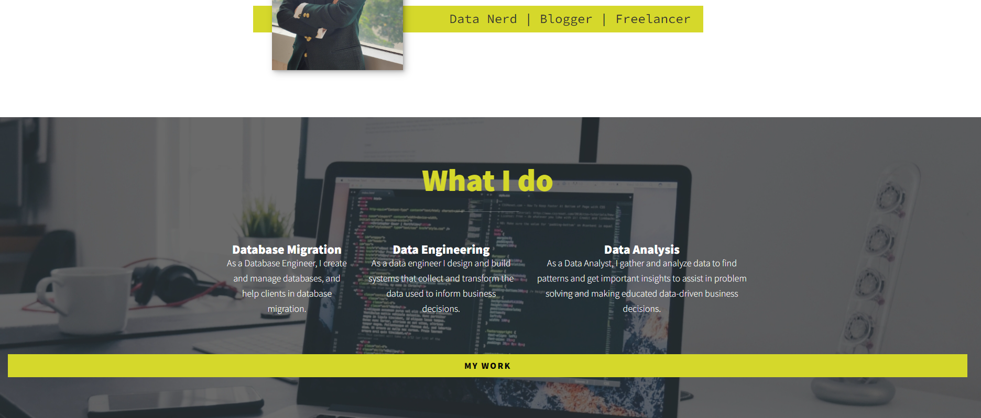
SAAD
Notes:
Here is how the AWS website will look like, it has

Slide 9
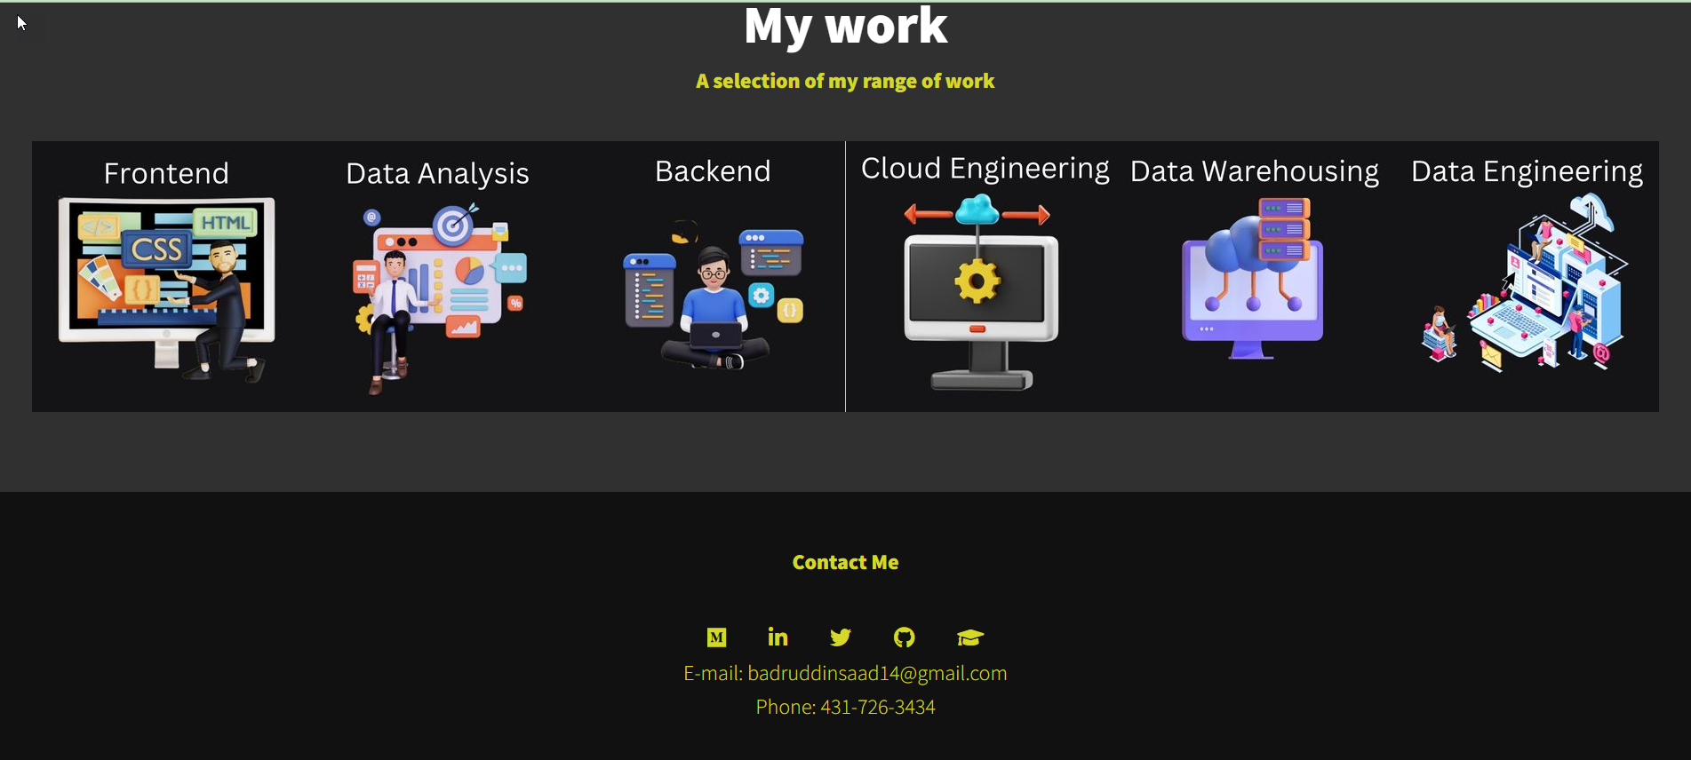
SAAD
Notes:
Here is how the AWS website will look like, it has

Slide 10
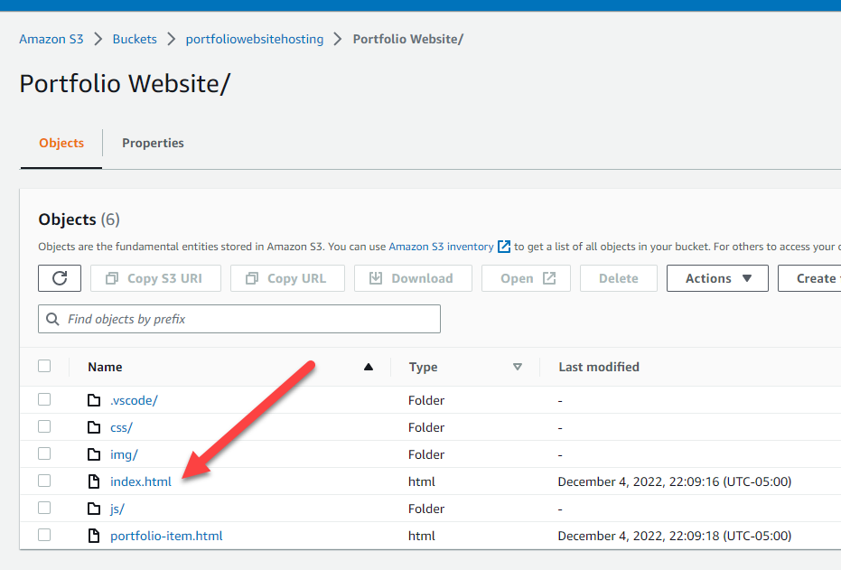
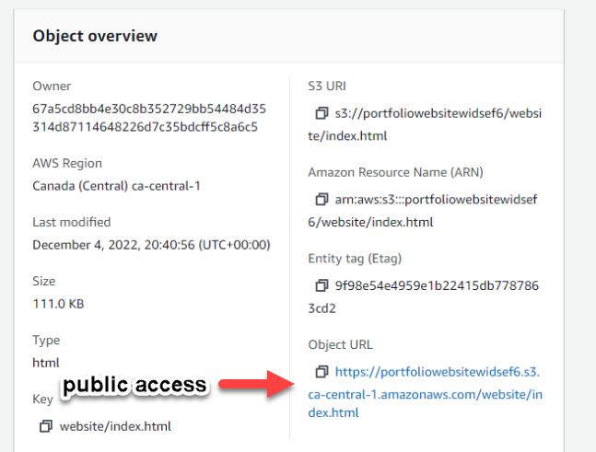
www.msaad.co.in
SAAD
Notes:
He you can see all the objects –HTML, CSS and JS files are uploaded to a unique bucket name, and there is the end point URL, link to our index.html objecvt which can be shared publically.

Slide 11
QUESTIONS? COMMENTS?
LET US KNOW!
EMAIL
SAAD -
msaad24@mail.mycentennialcollege.ca
Notes:
And that brings me to the end of my presentation, let me give you a summary of what I’ve been talking about over the last few minutes:
We have started with what cloud computing is, and how we can host any website in a leading cloud platform- AWS, in doing so we have learnt basic terminology used in storage service, and learnt what we can do take this project to a next level, by configuring domain name and practicing CI/CD.

Slide 12

ALWAYS REMEMBER
Turn ON Billing Alerts
CLOUD GUY
Notes:
You only have $300 in free credit from AWS, GCP or AZURE.
S3 pricing example: if you store 5GB of content, you’d pay $0.15 per month. If you created your account in the past 12 months and you’re eligible for the AWS Free Tier, you’d pay $0.00 per month.
Amazon Route53 pricing is based on three things: the number of domain names managed (paid annually), the number of Hosted Zones you use, and the number of end user queries for your website. In addition to purchasing domain name -$11-12 annually, The hosted zone for your site will cost $0.50 per month.

